Slide 1
OHS
Induction for RHD Students
Notes:
This presentation is about some important safety systems and practises we have in place at the University of Queensland and the Faculty of Medicine and Biomedical Sciences. The University and everyone on a UQ site as well as everyone conducting University business have obligations under the work health and safety legislation. The University puts systems in place to fulfil these legislative obligations and to achieve the highest attainable level of safety. It is important that you know what your obligations are and how they should be managed.
As an undergraduate student receiving tuition your obligations are at a lower level, however as you start to perform more hands-on work; either through clinical placements or by participating in research projects; your obligations will increase.
Disclaimer: This presentation is a broad overview of safety at UQ. This information is not legal advice.
It is important that you also receive a local safety induction for all sites you will be working at.

Slide 2
Faculty of Medicine OHS Contacts
Paul Lovelock
Manager, Occupational Health and Safety
Faculty of Medicine
p.lovelock@uq.edu.au
33464762
Deon Knight
Occupational Health and Safety Manager
Infrastructure and Research Operations (Medicine)
deon.knight@uq.edu.au
0419524362
Mrs Robyn Oram
School Safety Manager
School of Biomedical Sciences
r.oram@uq.edu.au
+61 3365 3221
Notes:
These are the key safety people in the Faculty of Medicine. Paul Lovelock leads OHS for the Faculty of Medicine. Robyn is at St Lucia at the School of Biomedical Sciences. Deon looks after the other remote and regional sites.

Slide 3
LEGISLATION & CODES
Work Health and Safety Act 2011
Imposes obligations on people at workplaces to ensure workplace health & safety
Work Health and Safety Regulations 2011
If there is a regulation about a risk, you must do what the regulations says
Codes of Practice
If there is a Code of Practice, you must either:
Local Policies, Procedures, Guidelines
Do what the Code says; or
Adopt and follow another way that gives the same level of protection
Notes:
Health and Safety legislation has this tiered structure, with each level going into more specific detail. At the top is the Work Health and Safety Act 2011, which talks broadly about the powers of the regulatory bodies and people who administer the Act, as well as the obligations on employer and employees at workplaces. Next is the Work Health and Safety Regulations which gives more detail about the kinds of safety systems required for some broad risk categories. The next level contains codes of practice which define how specific workplace procedures should be performed. And finally there are the organisational policies, procedures and guidelines which give you the specific local information. Procedures at the lower more specific levels will seek to enhance, clarify or add to information from the levels above it without contradiction.

Slide 4
OHS RESPONSIBILITIES
https://ppl.app.uq.edu.au/content/2.10.04-staff-responsibilities-occupational-health-and-safety
Comply with safe working procedures
Use of appropriate personal protective equipment and safety systems
Assist with the preparation of risk assessments
Report OH&S Issues
Notes:
Everyone at a University site or performing university business has obligations under the WHS Act, which vary depending on where you are in the organisational hierarchy and your assigned duties. For example, people supervising other members of staff or students have additional responsibilities.
Shown on this slide are the obligations applicable to everyone. ‘OHS Issues’ can mean accidents, workplace acquired illnesses, potentially dangerous events (near misses), or a previously unidentified or inadequately managed workplace hazard.

Slide 5
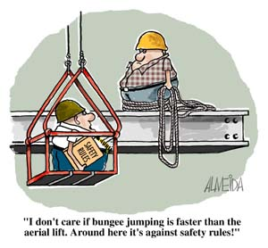
MAXIMUM PENALTIES
Three categories of offences:
Category 1: recklessly expose a person to
risk of death or serious injury or illness
30000 PU corporation, 6000 PU officers, 3000 PU workers or
5 years imprisonment
Category 2: expose a person to risk of death or serious injury or illness (without recklessness)
15000 PU corporations, 3000 PU officers, 1500 PU workers
Category 3: fails to comply with WH&S duty
5000 PU corporations, 1000 PU officers, 500 PU workers
Notes:
The penalties for breaching the WHS Act can be very serious for both the organisation and the individuals involved.
The Act says if an employer sets out a policy to do something as part of it’s safety system, that requirement becomes an enforceable duty under the Act. For example, if UQ says you must complete a particular form or training module for your orientation, that is part of the safety system of the organisation. If you fail to do it then you may be in breach of the WHS Act and could be found guilty of a Category 3 offense.
Note the wording of Category 1 and 2. There doesn’t have to be a death or injury to be in breach of the Act. You only have to expose yourself or someone else to the risk.
In addition to these substantial fines, a conviction would cause enormous damage to the reputation of the organisation and our ability to attract grant funding.

Slide 6
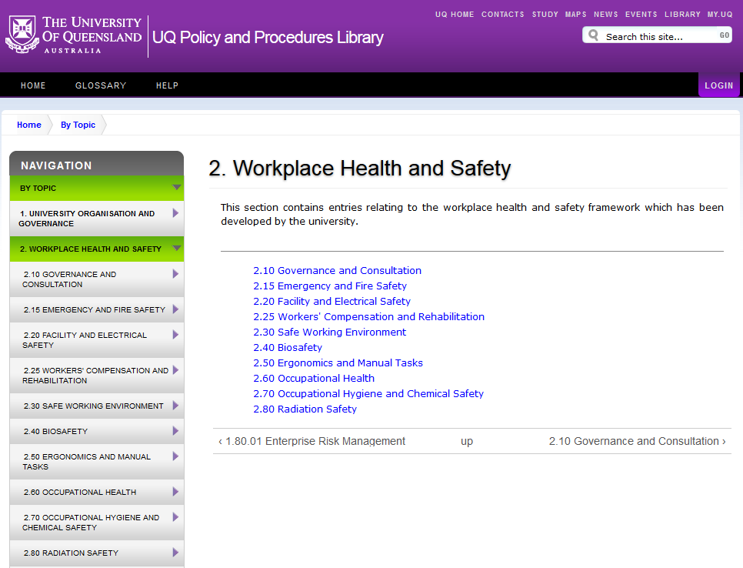
UQ PPL
https://ppl.app.uq.edu.au/content/2.-workplace-health-and-safety
Notes:
The UQ PPL is the central UQ repository for approved policies, procedures, guidelines and forms. It contains information for students, staff and the UQ community. It is a public site and content is accessible to anyone who can navigate to it. Workplace health and safety information is in Section 2, and has subsections as shown here. Each policy has a custodian and is periodically reviewed to keep pace with current industry best practice and changes to legislative requirements. Many of the required readings for your orientation come directly from the PPL.

Slide 7
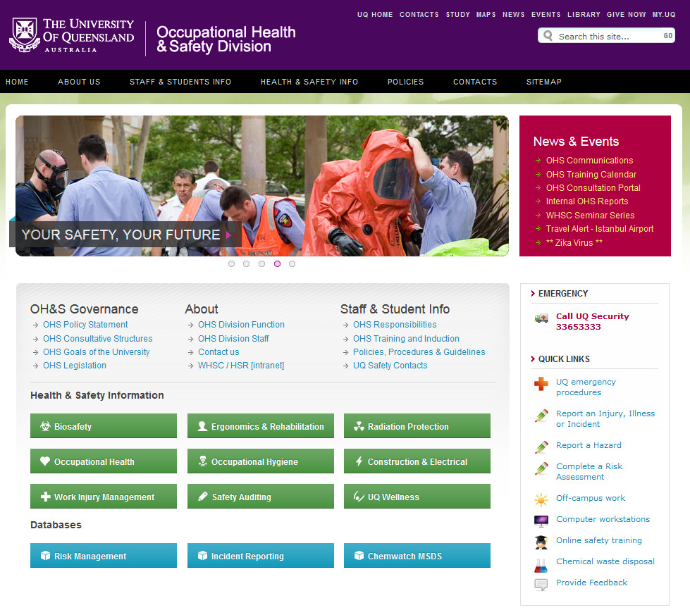
UQ OHS DIVISION
http://uq.edu.au/ohs/
Notes:
The University has an OHS division to administer the organisation’s safety systems. Their website is shown here. There is a lot of useful information linked from this homepage but three of the most important and frequently used are in the blue boxes along the bottom. The risk management database (RMD), the incident reporting database and the Chemwatch SDS database. We’ll take a quick look at each of these in the following slides.

Slide 8
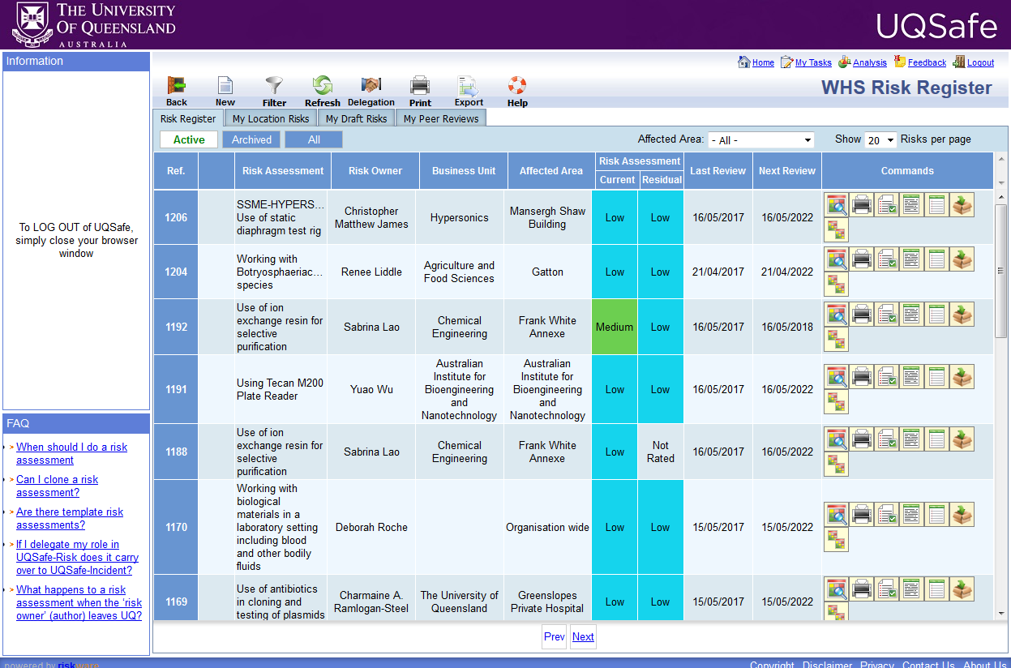
RISK MANAGEMENT
https://www.riskcloud.net/prod/?ccode=642
Notes:
Risk management is a core component of any occupational safety system. The purpose is to identify the hazards in the workplace, assess the risks associated with exposure to those hazards and to implement suitable controls which negate or minimise the risk of harm. All hazardous procedures must be assessed and the process must be documented. The UQ system for doing this is called UQSafe. Login with your UQ username and password. Once in the system you are free to browse and search through any assessment in the system.
Note that partnering organisations (hospitals, research institutes etc.) should have their own systems in place for risk management. As long as there is an established and robust system in place at the site; that you have access to; which informs you of the hazards and risks of a procedure and the appropriate control measures to use; then you may use that system for your placements instead of the UQSafe.

Slide 9
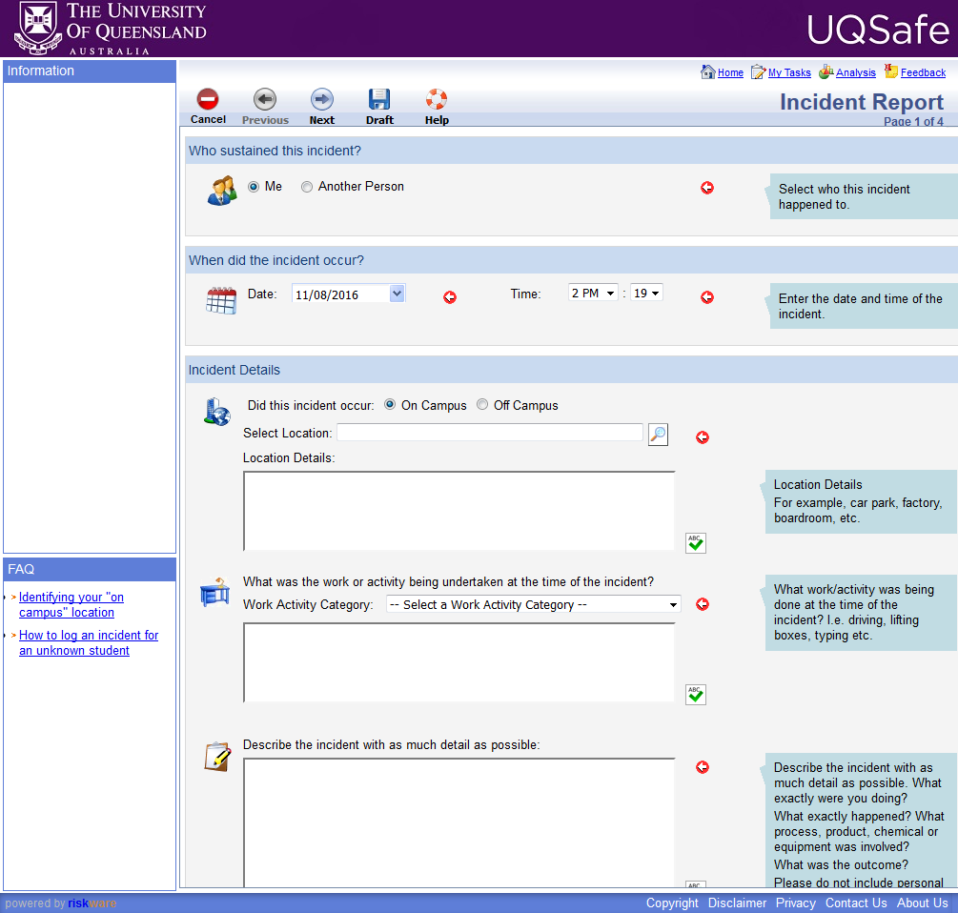
INCIDENT REPORTING
https://www.riskcloud.net/prod/?ccode=642
Notes:
This is the Injury, Illness and Incident Reporting Systems (or Incident Database). All work-related injuries, illnesses, dangerous events; with or without injury, i.e., near misses; must be reported on this system. When submitting a report be sure to nominate your supervisor. If your supervisor is from another organisation and doesn’t have access to the UQ system then nominate a UQ Workplace Health and Safety Coordinator or Manager for your area. Collecting this information is required for incident investigation and reporting to the regulator (Workplace Health and Safety Qld).
Please include as much detail as possible in these reports. There is a “prime directive” in accident investigations to not blame an individual for human error or the short comings of the safety systems around them. You will not be blamed or disciplined for any incident reported here unless there is a clear case of wilful negligence or misconduct.
The aim of this system is to:
Document and act upon near miss events before an injury occurs; and
To learn from our accidents. To identify where control measures have failed and find ways to minimise the likelihood of it happening again.
As before, partner organisations such as hospitals and research institutes should have their own systems in place for reporting incidents and may require you to use their system. However for accidents and incidents we ask that you DO submit reports to the UQ system, even if you use the partners system too. Incident reporting is a vital tool for improving our safety standards and procedures.

Slide 10
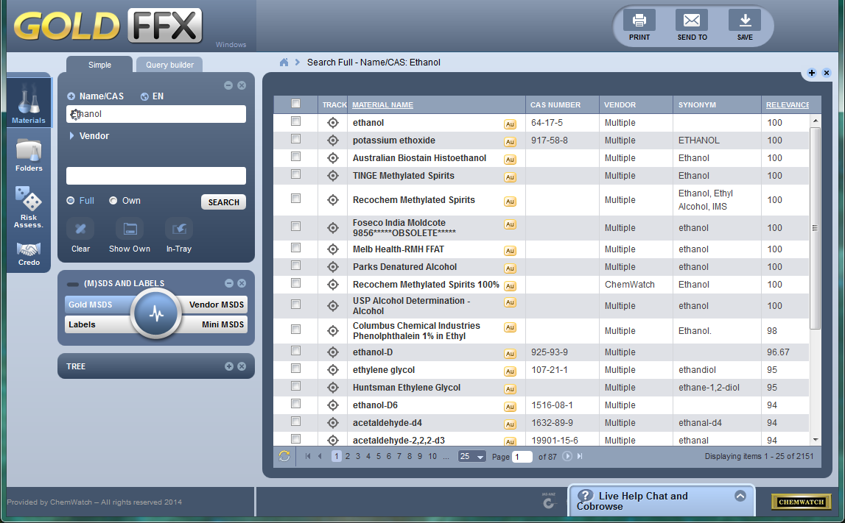
CHEMWATCH FFX
http://www.uq.edu.au/ohs/?page=231749
Notes:
Manufactures and suppliers of hazardous chemicals must provide safety information about the substance in a document called a Safety Data Sheet (SDS). These must be made available to any worker using hazardous chemicals. UQ has a subscription to Chemwatch which is a database of over 20 million SDSs.
You should consult the SDS for a chemical:
Before you order or obtain a chemical so you know how to store it.
Before you start using it, during the risk assessment process
When modifying a procedure or substituting a one substance for another
If you need to clean up a spill of the chemical
If someone has received a hazardous exposure to the chemical (provide a copy of the SDS with the casualty if receiving further treatment or emergency care).
Anytime you want to refresh your knowledge of how to safety use the chemical.

Slide 11
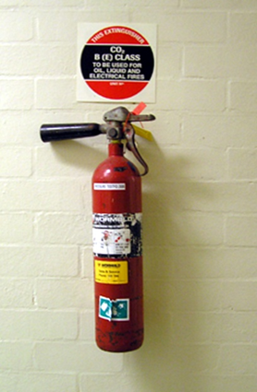
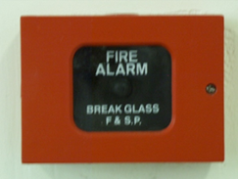
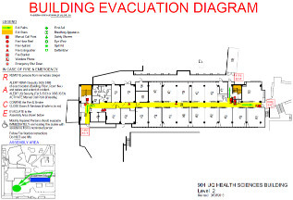
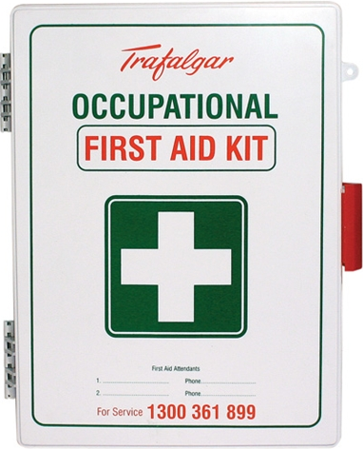
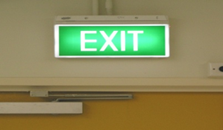
EMERGENCY
Locate in your work area:
First aid cabinets
Fire extinguishers
Break glass alarms
Emergency evacuation diagrams
Egress routes and exits
Emergency assembly areas
Notes:
This information should all be covered in your site safety inductions. Ensure you know the locations of these items and pathways for each location you work in. You don’t want to be trying to find this stuff when alarms are blaring at you with people panicking and you’re surrounded by smoke and fire. Knowing ahead of time where to find these resources and how to escape is vital in an emergency.

Slide 12
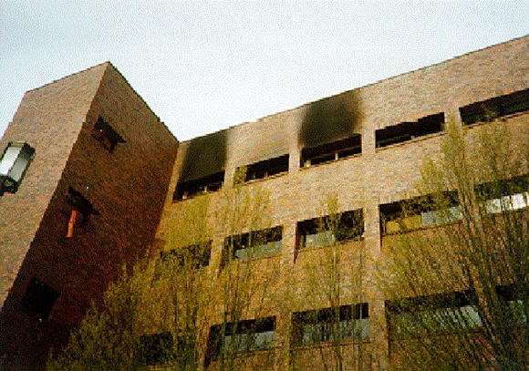
FIRE EMERGENCY
R.A.C.E.
Remove people from immediate danger
Activate manual fire alarms (break glass)
Call the emergency number for your area:
UQ 3365 3333
PAH 3176 6666
RBH 000 or 3646 5188
External sites 000
and alert nearby staff
Confine fire or smoke, but don’t close windows that have opened
Extinguish if safe to do so, if not prepare to Evacuate
Notes:
The RACE acronym is used in many workplaces as part of their fire and emergency procedures. Please be aware that there may be variations to this in some environments, especially healthcare facilities. This will be covered in more detail at the local site safety induction for the area.
No one at UQ is required to operate a fire extinguisher, but you may use one if you wish to attempt to put out a small simple fire. Before you begin make sure you have a clear path to your exit point.

Slide 13
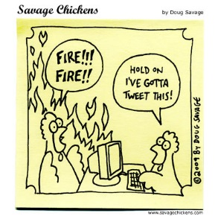
EVACUATION
Warning or Alert Alarm (blat, blat, blat)
Check your area for fire, smoke, etc.
Prepare to evacuate
Take valuables and keys
Evacuation Alarm (woop, woop)
Assist disabled or persons with special needs to the fire stairs
Exit building by nearest exit, follow wardens instructions
Do not use the lift
Assemble in your designated assembly area.
Notes:
Assuming a fire or emergency isn’t in your immediate area then the first you will know something is wrong is when you hear the building warning alarms. Most workplaces use a two-tone alarm system.
The first tone is the ‘Alert’ tone and will sound for 2-3 minutes. You should use this time to make your work area safe and prepare to evacuate. Save your open files, grab important belonging such as keys, your phone and your bag or wallet. By the end of this alert phase you should be ready to stand up and walk directly to the exit.
The second tone is the ‘Evacuate’ tone. When you hear this tone evacuate the building immediately and head to the assembly area.
Do not re-enter the building until instructed to do so by the attending fire and rescue personnel or the building warden.

Slide 14
MEDICAL ATTENTION
Local First Aid Officer/Volunteer
St Lucia Medical Centre (Dr Tony Arklay)
healthservice@uq.edu.au
+61 (7) 3365 6210
UQ Healthcare Super Clinic at PACE
+61 (7) 3346 1122
Hospital Emergency Department
Local GP
Ensure you submit one incident report for UQ and another for the teaching partner (e.g., Queensland Health) if required.
Notes:
Medical help is available from a number of sources. The St Lucia medical centre offers a number for services and is bulk billed for students. Costs of immunisations and medications are the responsibility of the student.

Slide 15
CONTAMINATED SHARPS
Notes:
Contaminated sharps injuries are one of the most common injury types we have at the school.
First aid for these injuries is to washed with soap and water. Allow the wound to bleed but avoid squeezing and rubbing the affected site. Splashes into the eye should be flushed using an eye wash fountain or saline with eye open for at least 30 seconds. If splashing to the face occurs then gentle washing and rinsing several times with water should be used for the skin, nose and mouth.
Immediately following such incidents, advice from a medical practitioner should be sought. Appropriate advice can be obtained from the UQ Health Services, hospital infection control or from a general practitioner. If it is a high risk injury you may have to receive prophylactic treatment within a few hours.
A baseline blood test is done with follow up tests 3 and 6 months later, although these may not be require if the risk of infection is assessed as very low, e.g., where the source patient is proven to be negative.
The incident should be reported to the supervisor and also reported on the Incident reporting database.

Slide 16
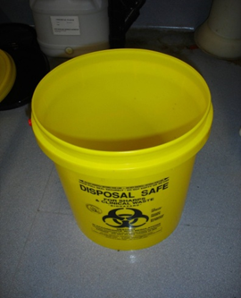
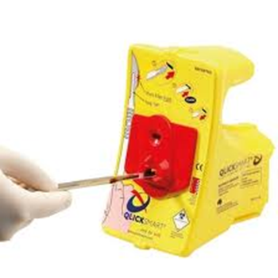
SHARPS
Sharps such as
needles
blades
syringes
Glass pipettes
must be discarded into a sharps container
Scalpel blades should be removed & disposed of via a no-touch remover such as a Qlicksmart device
Notes:
Always discard sharps to an Australian Standards approved sharps receptacle.
Don’t recap needles….. but if you must recap a needle use a cap holder or a one handed technique so as to avoid puncturing your hands and fingers by accident.
It is preferable to discard a used syringe whole. Don’t disassemble the needle and syringe if it is not necessary.
Do not manually remove scalpel blades from handles. Use a safety device deigned for this purpose.

Slide 17
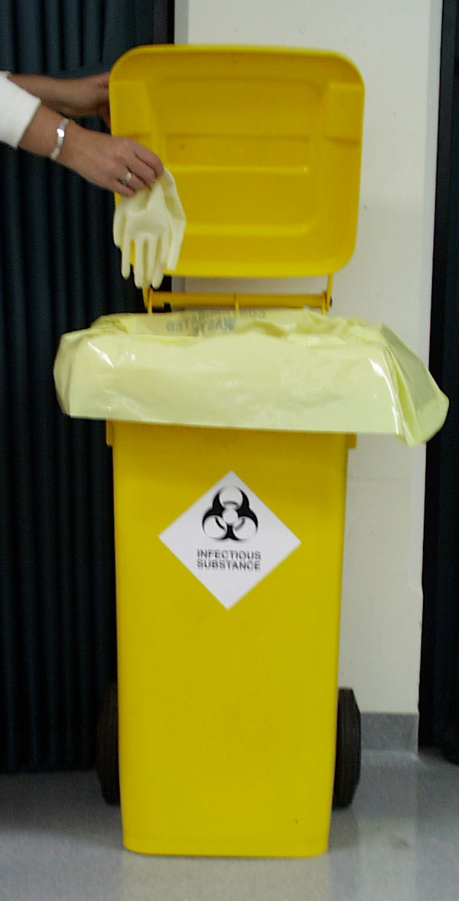
CLINICAL WASTE
Yellow bins and liners
Waste contaminated with potentially infectious biological material.
Genetically modified material.
At UQ sites “Perceived contaminated” waste should be treated as clinical waste and must not be discarded to general waste.
This varies at other sites so check the local procedures.
NO SHARPS!
Notes:
Research labs and healthcare facilities both use a Clinical waste stream although their procedures vary.
PC2 Research labs may require infectious waste; such as blood, human tissue and genetically modified organisms; to be neutralised before being discarded to clinical waste. Neutralising may be achieved by autoclaving or chemically treating it with a disinfectant like Biodyne or bleach.
Healthcare facilities don’t need to worry about this and discard infectious waste directly to the clinical waste stream. Healthcare facilities tend to allow uncontaminated or lightly contaminated material like used examination gloves or cotton balls to be discarded to general waste. Research environments typically don’t allow this and ensure that all this ‘perceived clinical waste’ goes into yellow bins.

Slide 18
QUESTIONS
Deon Knight
OHS Manager
deon.knight@uq.edu.au
0419524362
Notes:
Fake snow in this scene is pure white (Chrysotile) asbestos fibres.

Slide 19
THANK YOU

