Slide 3
Thank you
Dr Kim Peters | Senior Lecturer
School of Psychology
kpeters@uq.edu.au
07 0000 000
facebook.com/uniofqld
Instagram.com/uniofqld

Slide 4
Thank you
Dr Kim Peters | Senior Lecturer
School of Psychology
kpeters@uq.edu.au
07 0000 000
facebook.com/uniofqld
Instagram.com/uniofqld

Slide 5
Instructions for using this template
PowerPoint 2007, 2010, 2013 & 2016

Slide 6
Slides in this template
The following slides are instructions for using this PowerPoint template.
They also contain examples of programmed styles, charts and diagrams.
When you are ready to begin your presentation, delete the slides by selecting them in the left thumbnail window and pressing ‘Delete’ on your keyboard.
If you are unsure of how to use the template, you can leave these slides in the presentation and insert new slides before or after. Remember to delete them before finalising your presentation.

Slide 7
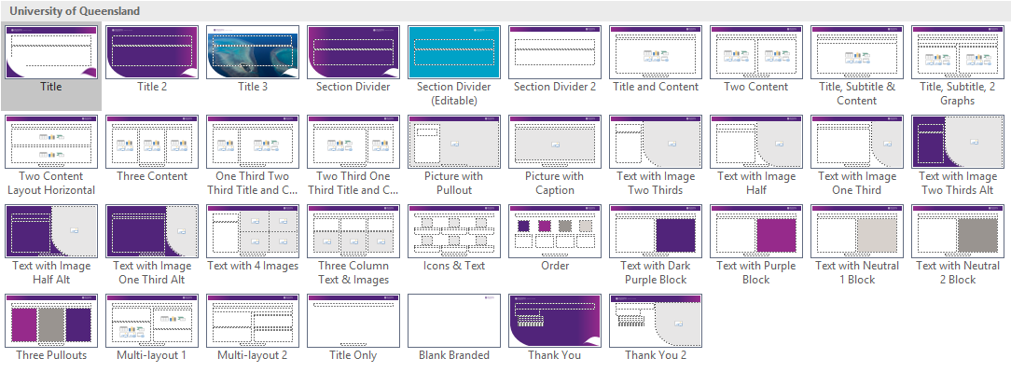
Slides in this template

Slide 8
New slides
Choose ‘New Slide’ from the ‘Home’ tab on the ribbon.
Select the desired layout from the thumbnails in the dropdown or after the slide has been chosen by choosing the ‘Layout’ button (next to ‘New Slide’).
There are options for different text and content layouts.

Slide 9
Title and content slide layout
Content text is entered here.
The layouts have 3 options for bullets set up in what is called a level system. To change the text to the next list level design, press ‘Tab’ at the start of the line (or use the ‘Increase List Level’ button).
Pressing ‘Shift+Tab’ (or the ‘Decrease List Level’ button) will take you back through the bullet list levels.
Content areas
In any of the slides, the text area can also contain other content.
You will notice under the “Click to enter text” line are icons displaying options to insert graphs, pictures, videos, Excel tables etc.

Slide 10
Text levels and content areas
This is the first level used as body text
This is the second level
This is the third level
This is the fourth level
This is the fifth level used as a Heading 1 or Subheading in the content area
This is the sixth and final level used as Heading 2 in the content area
This is the first level used as body text
This is the preferred numbering hierarchy. 1cm indents.
This is the third level
This is the fourth level

Slide 11
Formatting existing presentations
(except different dimensions, e.g.4:3 to 16:9, see next slide)
You can easily insert and re-format slides from existing presentations.
Select the slides in the existing presentation via the slide thumbnails panel to the left of the program
Copy, then paste into the template presentation slide thumbnails panel
Choose the ‘Layout’ for each slide as appropriate
Make sure to select the Slides once more and choose ‘Reset’. This will ensure all items within the slide are forced to adopt the new layout.
Any custom slide layout masters in old presentations/templates will copy through. In these cases it is best to copy content from inside text areas rather than the whole slide.

Slide 12
Formatting 4:3 ratio presentations into this 16:9 template
As per previous slide select, copy, paste slides into the slide thumbnails panel
Change each ‘Layout’ to a standard University of Queensland PPT Template layout
Make sure to select all slides once more and choose ‘Reset’. This will ensure all items within the slide are forced to adopt the new layout.
This action will copy over old presentation masters. To remove these:
Open the ‘Slide Master’ under the ‘View’ tab
Scroll to the end of the thumbnails panel and delete any slides after the ‘Full slide image’ layout.
Pictures may copy through with incorrect ratios (they may look squished or stretched). To correct:
Right click image
‘Size and Position’
Under the ‘Size and Properties’ area ensure ‘Scale Height’ & ‘Scale Width’ are the same percentage.

Slide 13
Changing footer, Entity Name and CRICOS code
Footer & Entity Name
Go to the ‘Insert’ tab
Select ‘Header & Footer’
Tick or untick the ‘footer’
Over type text into this footer area
Tick or untick ‘date’ which holds the Entity Name
Select the ‘Fixed’ date area and overtype the Entity Name where the existing text is
Tick or untick page numbers as required
‘Apply to all’.
CRICOS code
The CRICOS code is held in the master as all other available footer fields are in use.
To update:
‘View’ tab
‘Slide Master’
Click onto the very top slide (the University of Queensland master) and overtype the code
‘Close Master View’

Slide 14
File Size / Image Resolution
To reduce the file size of the presentation
PC
Go to the ‘Save As’ function
‘Tool’s dropdown (next to the ‘Save’ button)
‘Compress Pictures’
Select the option you want. The lower the resolution the smaller the file.
‘OK’
‘Save’
Mac
Click ‘File’
‘Compress Pictures’
Select the option you want. The lower the resolution the smaller the file.
‘OK’
‘Save’
File size issues - compress single pictures
If you know of a single image that is large in file size, you can reduce that particular image to a very low compression. This will mean there won’t be any quality reduction in the logos and other imagery in the presentation.
Select the image
Go to ‘Picture Format’ tab
Click on the ‘Compress Pictures’ button
Ensure ‘Apply only to this picture’ is ticked
Choose ‘Email 96 ppi’
‘OK’

Slide 15
File Size / Image Resolution
File size issues – external image compression
Sometimes the inserted images were too large to begin with. There is only so much PowerPoint can do to compress the images when in the program.
It is recommended that you reduce the large image files before inserting them to the presentation. This will ensure you don’t suffer slow computer performance.
As a guide, a photographic image at full slide size should be no more than 1mb.
A free program called ‘Image Resizer for Windows’ released by Brice Lambson is available online which allows the user to easily right-click and resize images in the folder location. It has minimal quality loss and significantly reduces image file size.
Check first with your IT department or relevant superior if you have authority to install this program.
Printing your PPT presentation:
It can sometimes be easier to print from a PDF rather than directly from PowerPoint. To create the PDF:
You can either print to the Adobe PDF printer (select from available printers); or
Save as Adobe PDF.

Slide 16
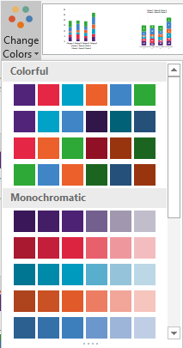
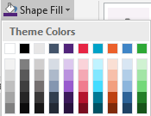
Chart/Smart Art colours
Chart and smart art colours are fully customisable.
By default charts will use the colour palette.
To change the whole chart’s colours use the ‘Change Colours’ menu under the ‘Chart tools→ Design’ tab:
Alternatively, you can select one of the chart elements (such as a bar or pie chart slice) and manually change the ‘Shape Fill’ under the ‘Chart tools → Format’ tab. The corresponding legend will update automatically.
The approved UQ colours are in the top row, starting from the 5th colour along.
These colours are automatically picked up in charts/smartart and can be used to create a more contrasting presentation.

Slide 17
The University of Queensland colours
Main colours used in this template:
Additional colours available for use:
R 81 G 36 B 122
R 230 G 38 B 69
R 0 G 162 B 199
R 235 G 96 B 43
R 64 G 133 B 198
R 46 G 168 B 54
R 150 G 42 B 139
R 215 G 209 B 204
R 153 G 148 B 144
R 200 G 174 B 115
R 251 G 184 B 0

Slide 18
Supplementary Table Slide
Custom table designs cannot be created in PPT or saved into the master setup (the selection shown in ‘New Slide’ or ‘Layout’ menus).
We have formatted a table below that can be copied and pasted as needed. Click on the outer edge of a table below and Ctrl+C to copy. Then click on the outer edge of the content placeholder where you want to paste the table and Ctrl+V to paste.
Be careful when deleting this instructional text that you do not delete the table slide as you may need it when compiling your presentation.
Table Heading | Table Heading
Table Text | Table Text

