Slide 1
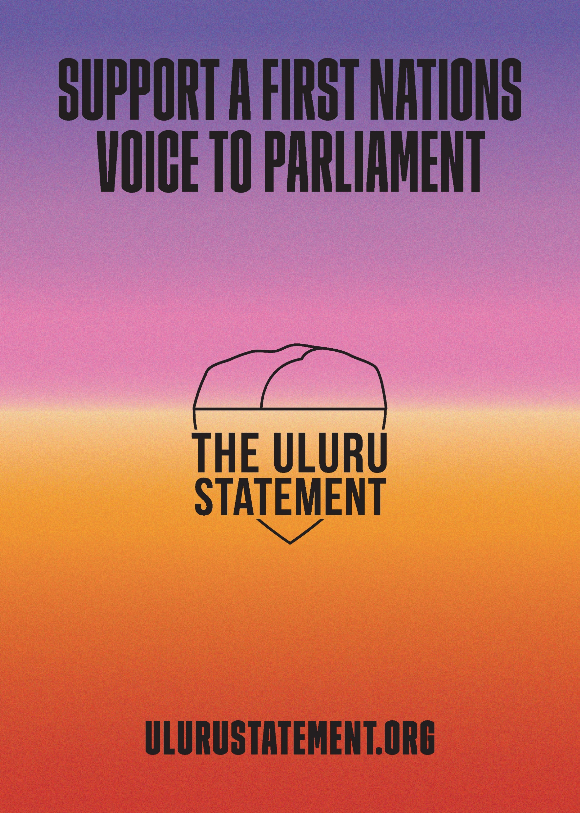
The Uluru Statement from the Heart in May 2017 was addressed to the Australian people and invited the nation to create a better future.
I support a First Nations Voice to Parliament, enshrined in the constitution.
I will share in this historic legacy by voting yes in the referendum to be held later this year.

